Slide 1

Research Paper Presentation
Mahima Bansod

Slide 2

In the past , computer security was a simple issue.
Involved installing antivirus on the clients machine
Did not guarantee full proof security
Reasons:
Attackers use different methods every time
Complex software created even more vulnerabilities.
Budget constraints made it more difficult for IT departments to implement new secure measures
Mobility made endpoints of an extended corporate network beyond complete control and users often tend to make mistakes

Slide 3

Endpoint security, email security, gateway-based Web security, and virtual private networks (VPNs).
Issues with Traditional approach:
Maintenance
Not Reliable
85% of all threats come via the web including threats as malware downloads, phishing sites and firewall breach that contains sensitive data.
Security breaches has always been the problem and cloud-based security is the right solution for such attacks.

Slide 4

Cloud based security is security principles applied to protect data, applications and infrastructure associated within the cloud computing technology.
Features that give it an edge over traditional methods are:
Agility
Scalability
Centralized control

Slide 5

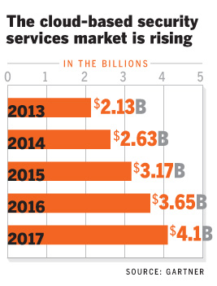

Slide 6

Large Enterprises
Government Agencies
Cloud Service Providers
Medium sized Enterprises

Slide 7

Mobility
Tablets and smart phones are being used at an alarming rate in all the organizations.
These devices use wifi networks, hotspots or cellular data that is not controlled by the IT
Cloud based web security allows the administrators to define a set of policies across the cloud and have them enforced on the users regardless of their devices or locations.

Slide 8

Distributed Enterprise
Due to globalization organizations today have offices all over the world.
All the traffic coming from different sources like the headquarters, home locations and the locations is directed to the cloud. Security policies are enforced through the cloud which creates a consistency in rules and are enforced on all the users irrespective of the location and the devices that they use

Slide 9
Reliability
Factors such as uptime, protection coverage, latency etc are also considered when setting up cloud based security systems.
A well designed solution has zero fault tolerance and will distribute a processing across hundreds of nodes deployed in redundant data centers worldwide

Slide 10
Scalability
Cloud based systems offers more elasticity and scalability on demand. The pay as you go adopted in cloud based systems do not force the businesses to invest upfront capital expenditure based on anticipated future needs.

Slide 11

It was observed that the top three cloud providers Amazon, Google and Microsoft account for about 56% of all non-transparent incidents of cloud vulnerability. From 2009 - 2011 the number of cloud vulnerability incidents has been doubled mostly due to the astronomical growth in cloud services.
Major cloud incidents are due to:
Vulnerability scanning
Web application attacks
Force attacks

Slide 12

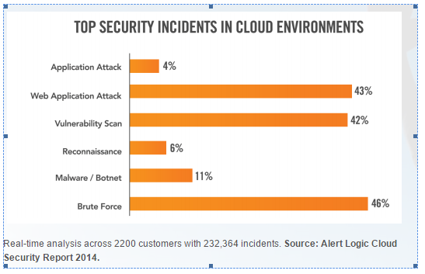

Slide 13

In the cloud, a key to be protected is a solid understanding of the shared security model that exists between you and the cloud provider.
Cloud provider: Foundational services like networking services, storage, database security etc.
You: Incident reporting, network threat detection, log analysis etc.

Slide 14

Secure your code
Create an access management policy
Adopt a patch management approach
Log management
Build a security toolkit
Stay informed

Slide 15

Cloud Computing is a subscription based service. On site equipment, major capital expenditure and large scale IT maintenance cost are being scrapped and giving way to services that can be easily deployed in the cloud and enabled and scaled on demand.

Slide 16
Cloud bases security provides perfect working environment for distributed and mobile workforce.
It is agile without any additional cost of maintenance. It gives superior web and email protection at a 60% lower overall cost and simultaneously eliminate all the hassles of managing their own equipment.

Slide 17
THANK YOU

